Slide 1
Organic Compounds/Macromolecules/Biomolecules

Slide 2
Organic Molecules AKA: Macromolecules/Biomolecules
Large molecules that make up our body. We eat them, digest them, then build them back up again to use.
4 macromolecules include:
1. Carbohydrates
2. Lipids
3. Proteins
4. Nucleic Acids

Slide 3
Building and Breaking Apart Organic Molecules
Macromolecules are usually assembled from basic building blocks –monomers. They are put together to form polymers.
Each monomer of a macromolecule are held together by covalent bonds
Condensation Reaction/aka Dehydration Synthesis: put them together (XH + XOH XX + H₂0)
Hydrolysis breaks them apart
(XX + H₂0 XH + XOH)

Slide 4
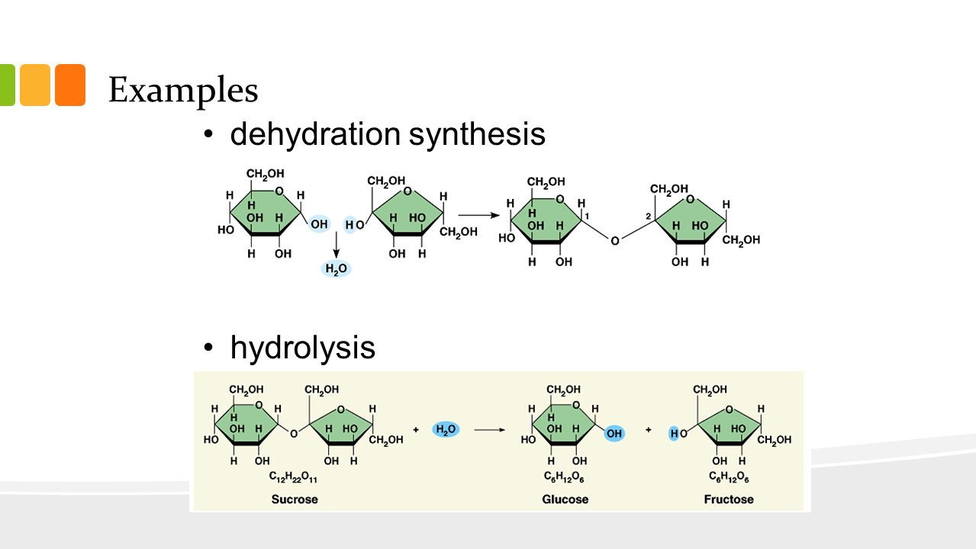

Slide 5
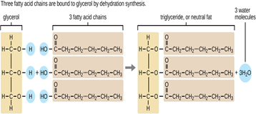

Slide 6
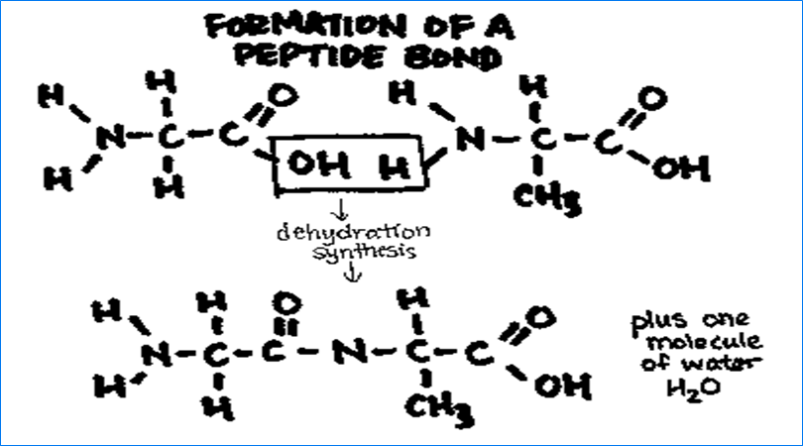

Slide 7
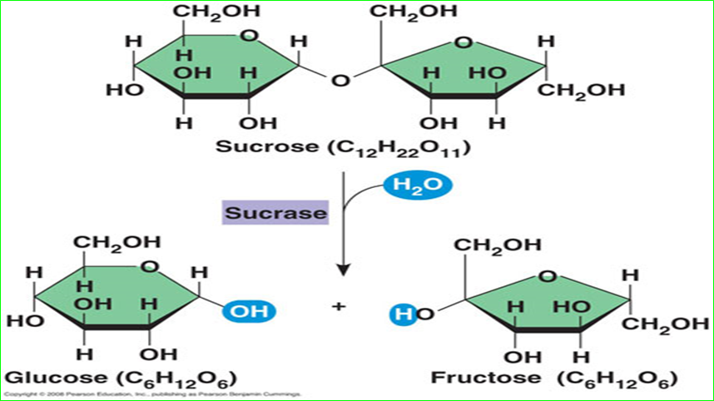

Slide 8
Carbohydrates (Polysaccharides)
Means “Carbon + Water”
Monomer: monosaccharide is (CH₂O)n
Contains C,H,O in a 1:2:1 ratio
Examples:
Glucose, Fructose- 6 carbon monosaccharides (can be chains or rings)
Ribose and Deoxyribose- 5 carbon monosaccharides
Sucrose and Lactose are disaccharides (2 mono linked together via condensation reaction)

Slide 9
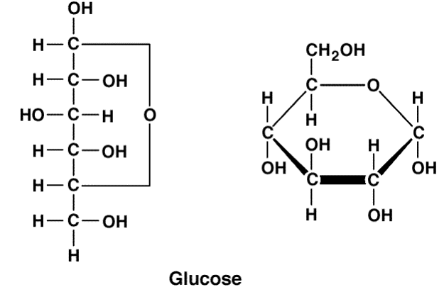
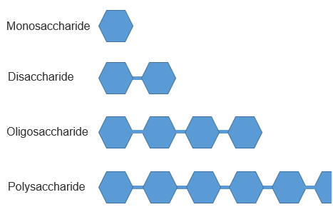

Slide 10
Functions
Monosaccharide/Disaccharides- quick energy source
Polysaccharides- energy storage and structural
Starch- how plants store energy
Glycogen- how animals store energy in liver and muscle cells
Cellulose- structural component in plant cells
Chitin- insect’s exoskeleton and fungi cell walls
Peptidoglycan- bacteria cell walls

Slide 11
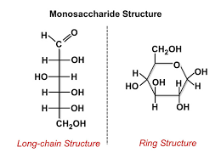

Slide 12
Practice Question: Figure formula of Polys
Polysaccharide formulas C_{n}H_{2n}O_{n} - # of water molecules used to bind them.
EX: What is the formula of a 10 glucose polysaccharide?
-10 glucose molecules (C₆H₁₂O₆) in a chain would lose 9 H20’s to connect them. So the formula would be C₆₀H₁₀₂O₅₁
For every connection you lose 1 H20 molecule. You will always lose 1 less water than the length of the chain (10-1=9)

Slide 13
Lipids
Insoluble in water- hydrophobic= main characteristics
3 types: fats, phospholipids, steroids
No true monomers
C,H,O unless a phospholipid (P)
Fats & Oils- Contain fatty acids and a glycerol
(fats-solids-most animal products, oils-liquids-most plant products)
Aka: triglycerides
High energy storage molecule- 9.3 cal/g vs 4.1 in carbs and proteins (due to all the H)- very compact and store energy in not a lot of space

Slide 14
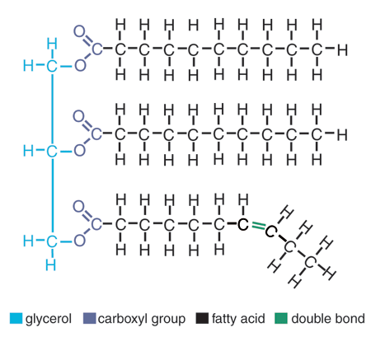

Slide 15
Saturated vs Unsaturated Fats
Unsaturated: have some double bonds between carbons. This causes “kinks” in the chain and keeps them liquid at room temperature. (oils/plant based) (stack of papers stack easily if placed right on top of each other. Every double bond gives paper a wrinkle and they can’t stay compact-liquid) (healthy fats)
Saturated: all single bonds between carbons. Every carbon is “saturated” with a carbon. They are solid at room temperature. (fats/animal products). No “kinks”

Slide 16
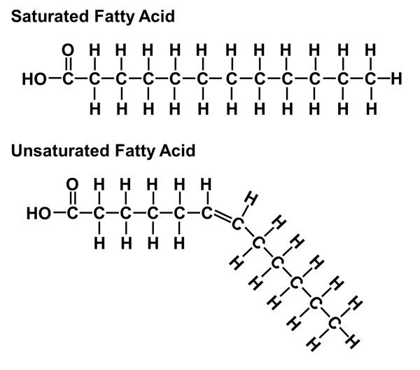

Slide 17
Lipids
Phospholipids- 2 fatty acids, a phosphate, and a glycerol
Have polar heads (phosphate/glycerol) and non-polar tails (fatty acids) arrange in double layer in water
Found in cell membrane

Slide 18
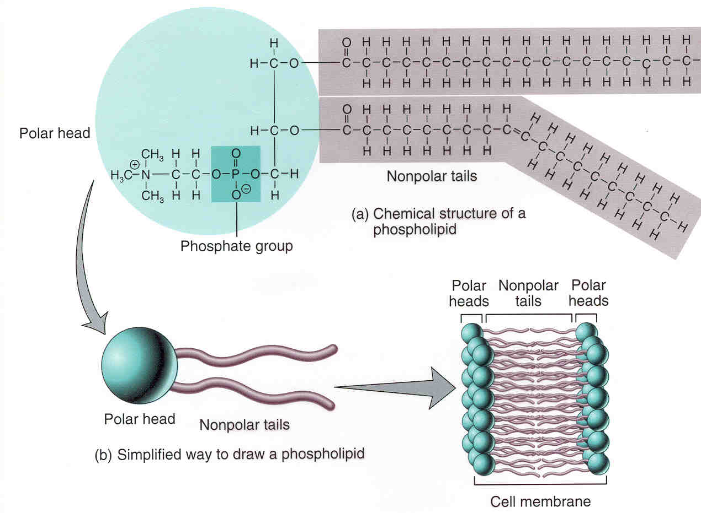

Slide 19
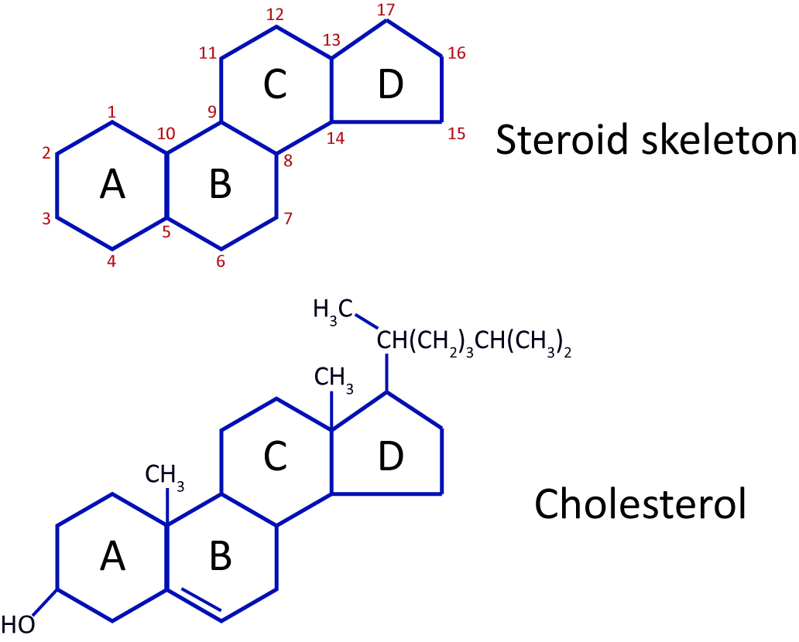
Lipids
Steroids- 4 fused carbon rings.
Cholesterol is the base unit of a steroid.
Includes sex hormones (testosterones, progesterone, etc)

Slide 20
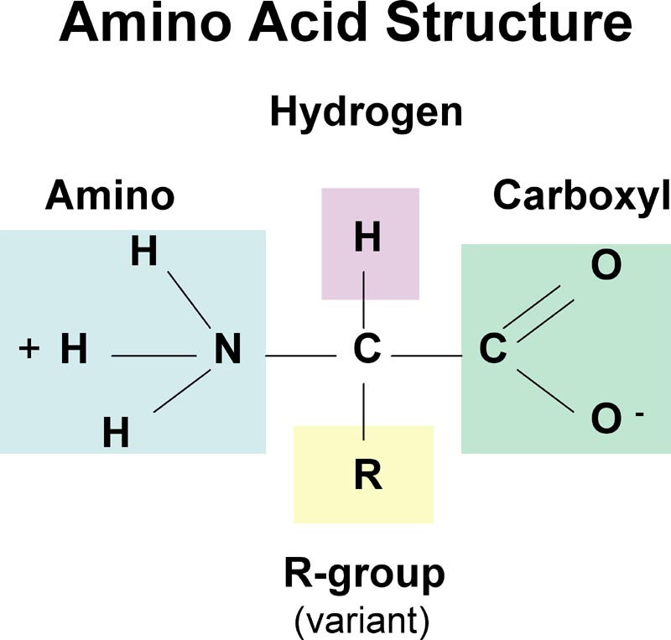
Proteins
Monomers: amino acids
Structure: Amino group, carboxyl group, and alpha carbon, hydrogen, and a R-group
Contains C,H,O, N and sometimes S
20 different kinds (differentiated by the R-group)

Slide 21
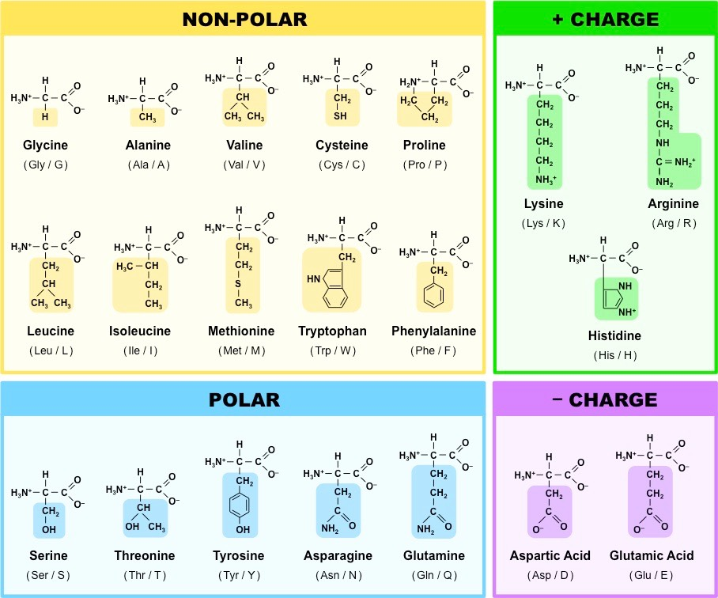

Slide 22
Proteins
Some R groups will repel each other, some will attract each other. This will determine how they are folded – which will determine the function of the protein.
Proteins are held together by covalent bonds called peptide bonds
Peptide bonds: condensation reactions between the H on one amino group and the OH on the carboxyl group of the next amino acid.

Slide 23
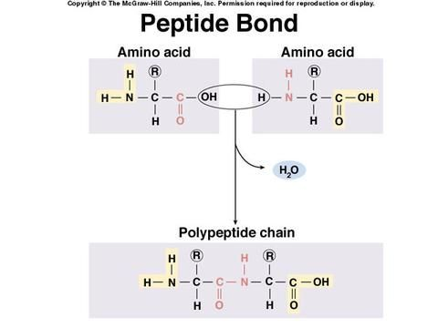
Dipeptide is 2 amino acids linked together

Slide 24
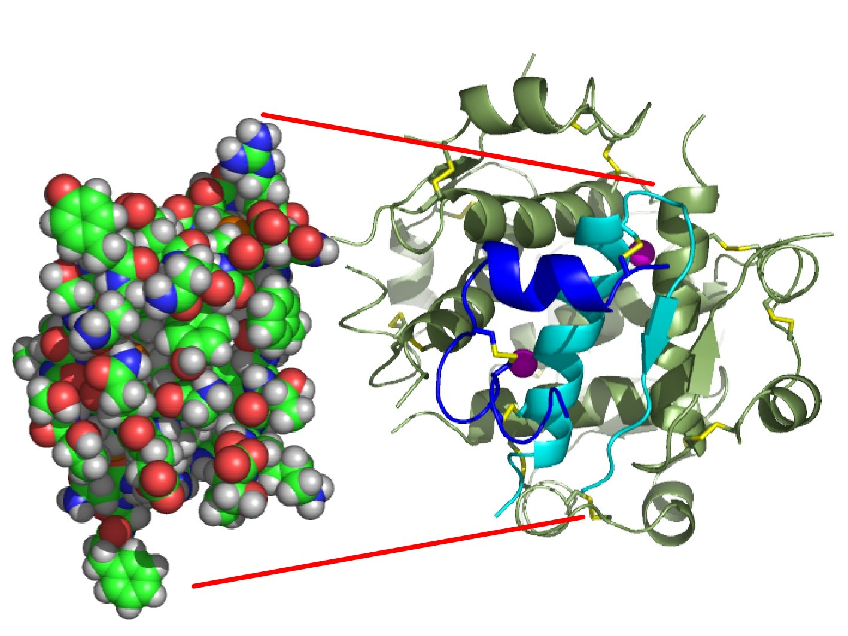
Proteins
Examples: Enzymes (speeds up reactions), keratin (structure of hair and nails), hemoglobin (carries oxygen in blood), elastin (structure of skin), hormones (other than steroids, i.e: insulin, growth hormone), collagen, pigments (melanin), antibodies (fight off diseases)

Slide 25
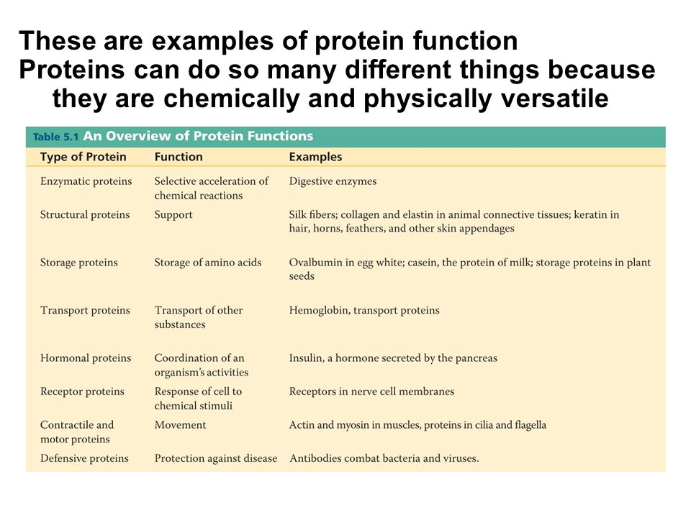

Slide 26
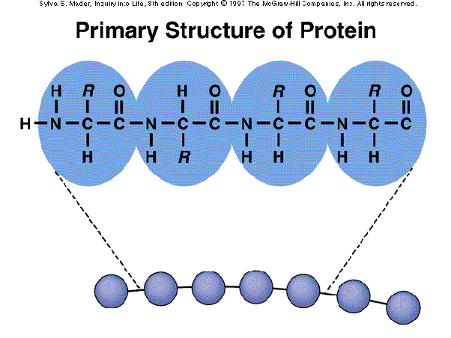
Protein structure
1. Primary- the order of amino acids in the chain. Look for the repeating NCC to count amino acids. (aka: polypeptide chain)

Slide 27
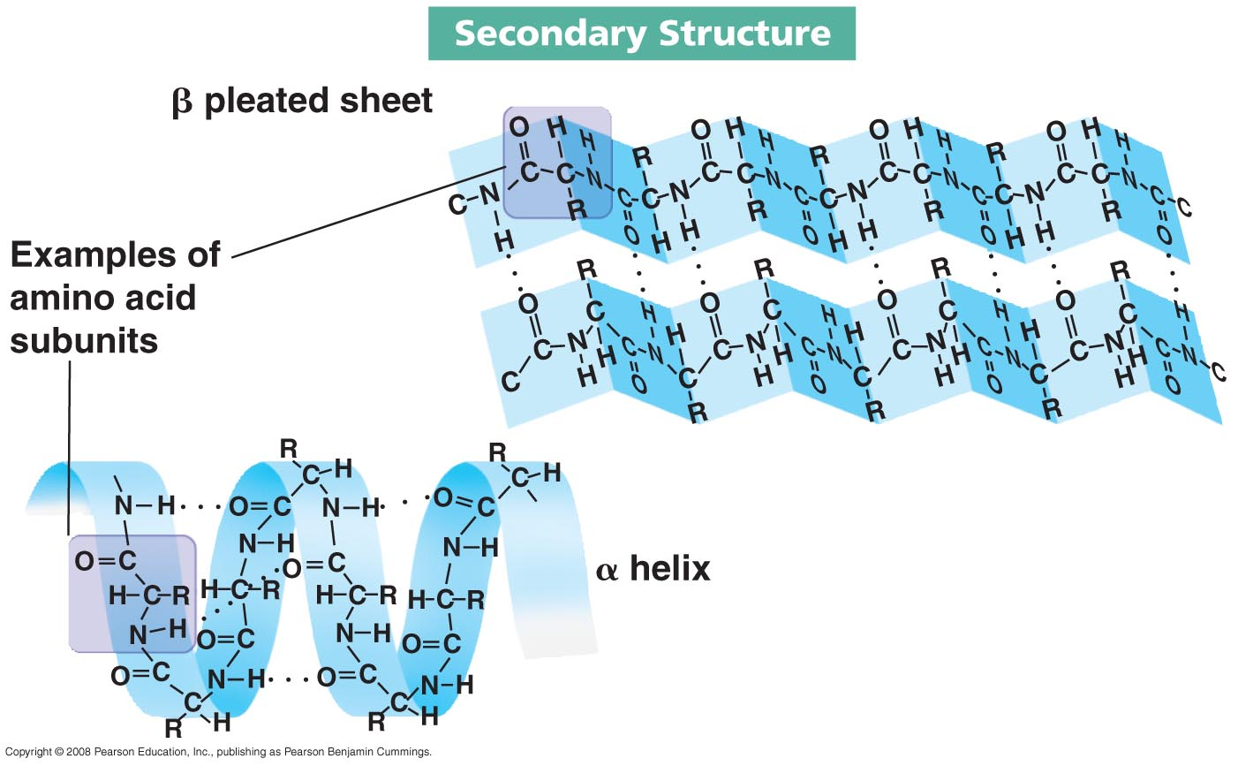
Protein Structure
Secondary Structure- caused by hydrogen bonding of amino and carboxyl groups of different amino acids- patterns form alpha helix or beta pleated sheets.
Proteins will have sections of both helixes and sheets

Slide 28
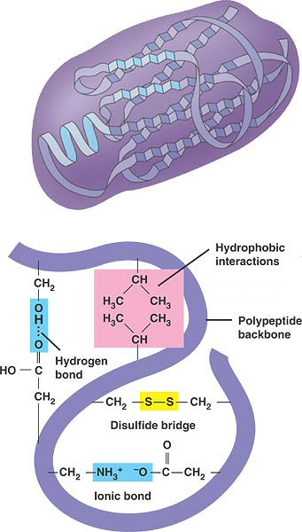
Protein Structure
Tertiary- R- groups interact with one another. The protein bends and twists itself into a 3D like shape.
Disulfide bridges, hydrogen bonds, ionic bonds all contribute to the tertiary structure between R-groups
Note: changes in ph and temperature will cause secondary and tertiary structure to break and DENATURE

Slide 29
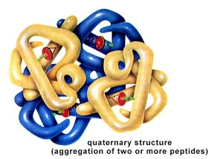
Protein Structure
4. Quaternary- Only some proteins will reach this level of structure. This is when the protein consist of multiple polypeptides. Example: Hemoglobin is made of 4 polypeptides. Insulin is also an example

Slide 30
Chaperonins
Complex proteins that help fold proteins correctly.

Slide 31
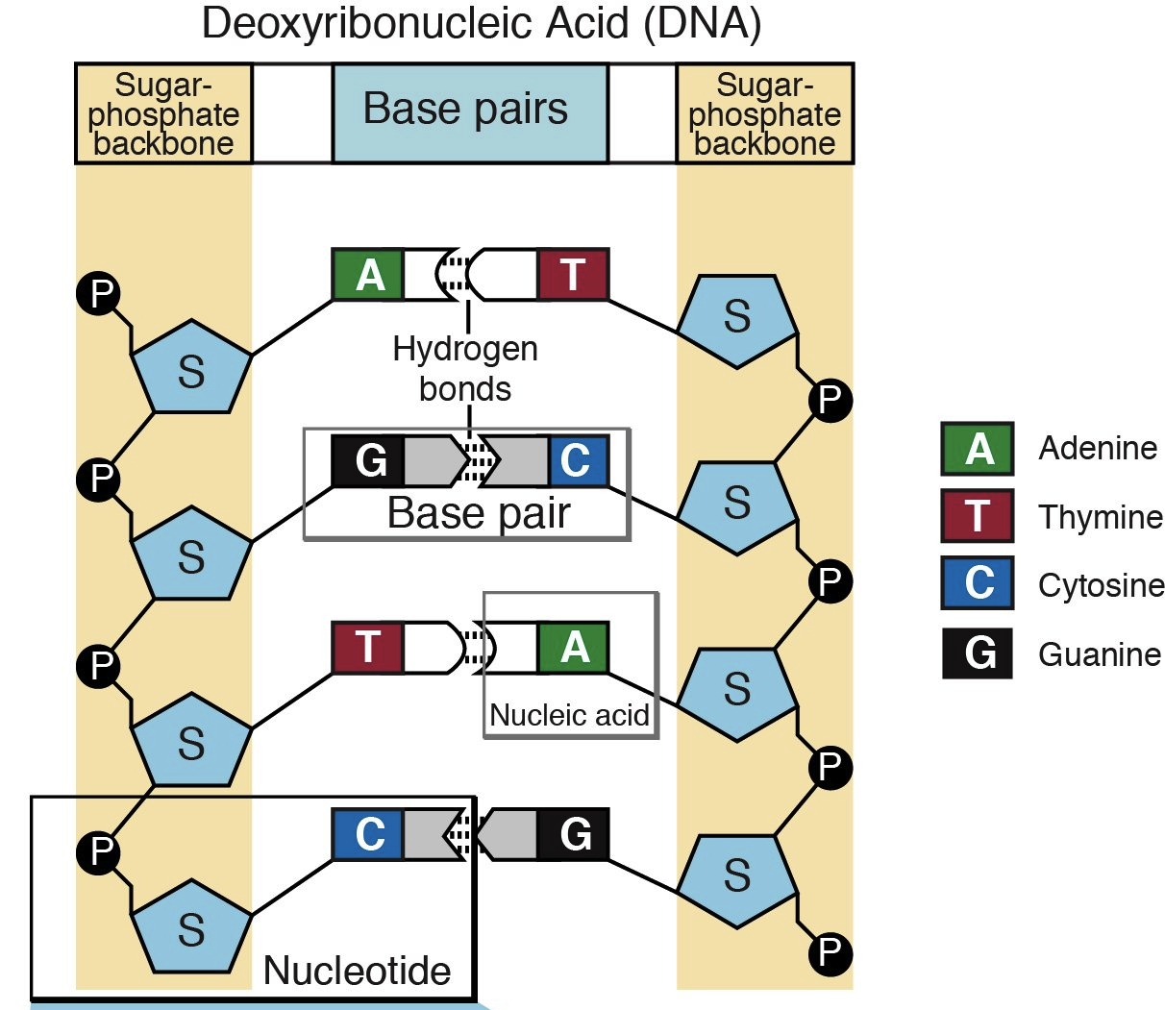
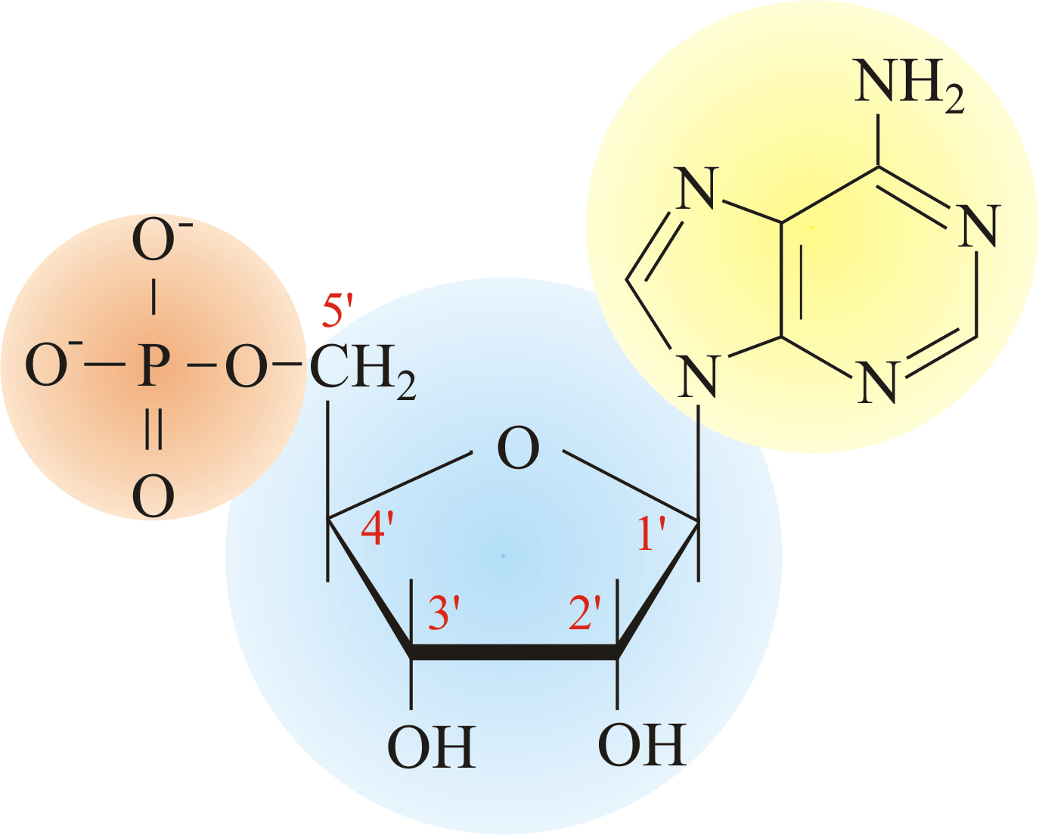
Nucleic Acids
Example: RNA/DNA
Monomers: nucleotide
Composed of: pentose sugar, phosphate, nitrogen base
C,H,O,N,P

Slide 32
Nucleic acids contain directions for making proteins.
Damage to nucleic acids (mutations) means faulty proteins are made (or not at all)

Slide 33
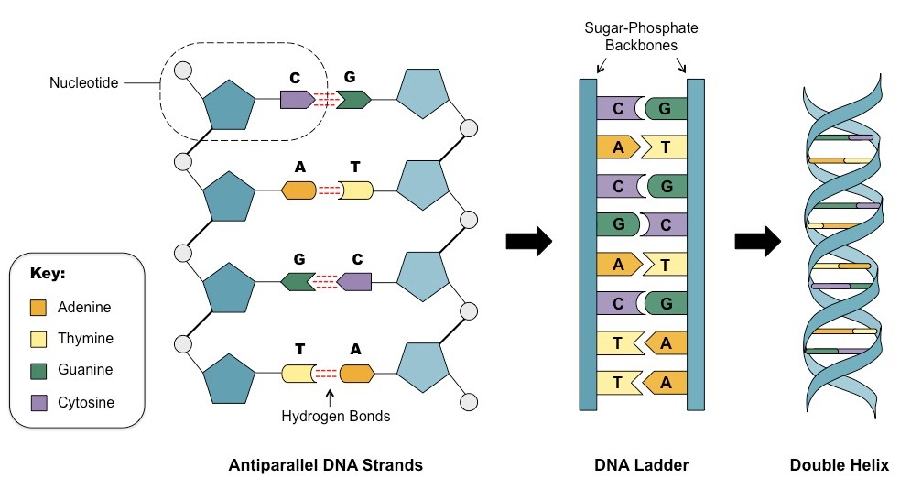
Usually double stranded
Contains Thymine not Uracil
Runs 5’ to 3’ one one strand and 3’ to 5’ on the opposite strand
Contains deoxyribose not ribose (missing hydroxyl group)

Slide 34
